Slide 1
NLP: Let the Machine Do the Reading
NER

Slide 2
Overview
Named Entity Recognition (NER) is usually the first step towards information extraction that seeks to locate and classify named entities in text into predefined categories such as the names of persons, organizations, locations, expressions of times, quantities, monetary values, percentages, etc.
By the end of this week you will be able to:
Identify the key concepts of NER
Use BERT model to do state-of-the art NER

Slide 3
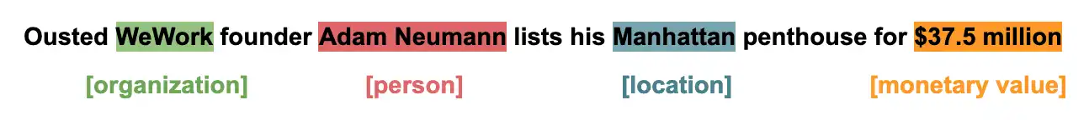
Introduction
Aka entity identification, entity extraction or entity chunking
The process of recognizing information units like names and numeric expressions from unstructured text.
The goal is to develop practical and domain-independent techniques in order to detect named entities with high accuracy.
Used in search efficiency, recommendation engines, customer service, automatic trading, and many more.

Slide 4
Entities
Entities are the most important chunks of a particular sentence such as noun phrases, verb phrases, or both.
Generally, entity detection algorithms are ensemble models of:
Rule-based Parsing
Dictionary lookups
POS Tagging
Dependency Parsing

Slide 5

Types of Entities

Slide 6
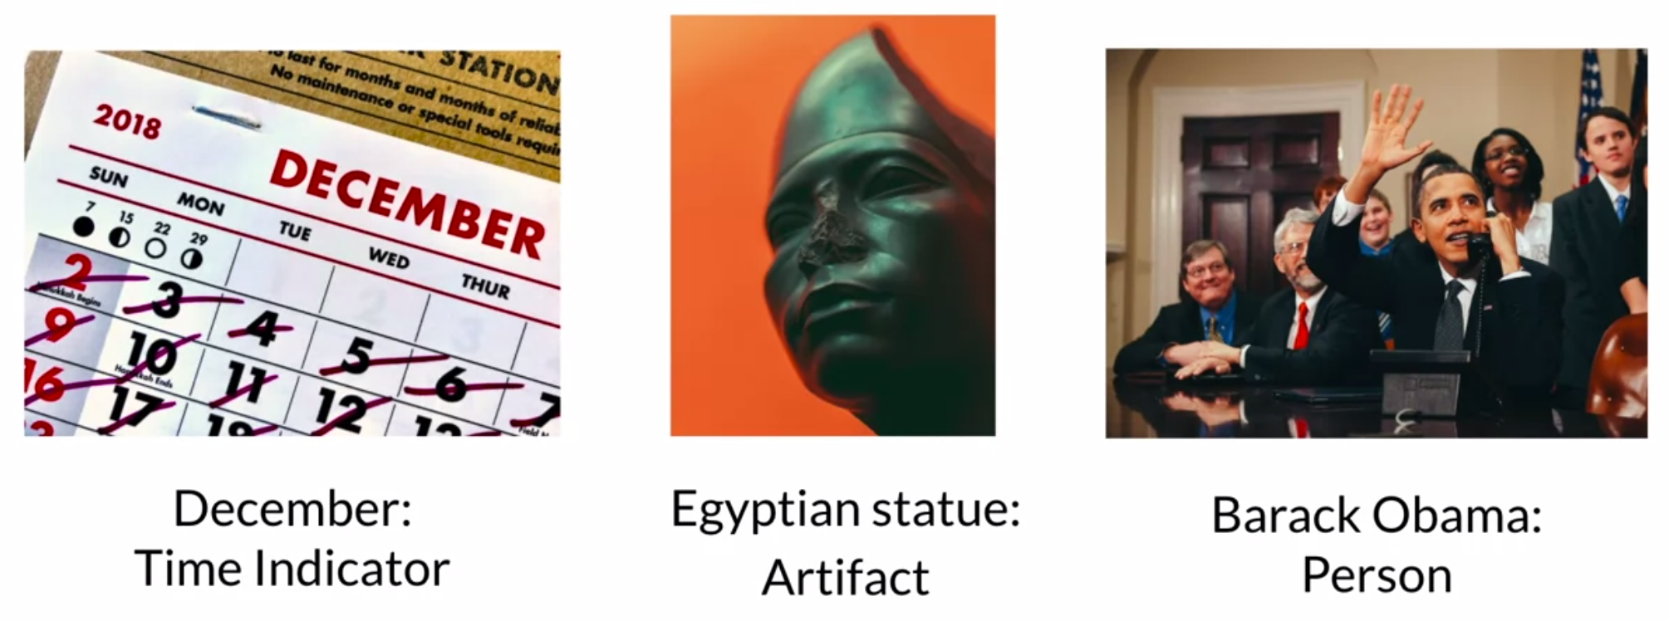
Types of Entities

Slide 7

Essential Info about Entities
geo = Geographical Entity
norp = Nationality, religious, political group
org = Organization
per = Person
gpe = Geopolitical Entity
tim = Time indicator
art = Artifact
eve = Event
nat = Natural Phenomenon

Slide 8
Question
Extract the named entities from the following sentence:
John ate Japanese food in midtown Manhattan
John, food, Manhattan
John, Japanese, midtown
John, Japanese, Manhattan
John, food, midtown

Slide 9
Question
Extract the named entities from the following sentence:
John ate Japanese food in midtown Manhattan
John, food, Manhattan
John, Japanese, midtown
John, Japanese, Manhattan
John, food, midtown

Slide 10
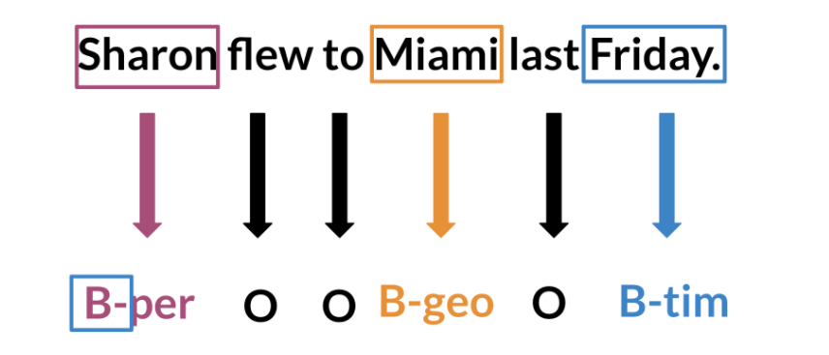
Inside–Outside–Beginning (Tagging)
The IOB (inside, outside, beginning) is a common tagging format for tagging tokens.
I- prefix before a tag indicates that the tag is inside a chunk.
B- prefix before a tag indicates that the tag is the beginning of a chunk.
O tag indicates that a token belongs to no chunk (outside).

Slide 11
Question
Extract the named entities with IOB tags from the following sentence:
John ate Japanese food in midtown Manhattan
John (B-per), Japanese (B-norp), Manhattan (I-gpe)
John (I-per), Japanese (I-norp), Manhattan (B-gpe)
John (I-per), Japanese (I-norp), Manhattan (I-gpe)
John (B-per), Japanese (B-norp), Manhattan (B-gpe)
John (B-per), Japanese (I-norp), Manhattan (B-gpe)

Slide 12
Question
Extract the named entities with IOB tags from the following sentence:
John ate Japanese food in midtown Manhattan
John (B-per), Japanese (B-norp), Manhattan (I-gpe)
John (I-per), Japanese (I-norp), Manhattan (B-gpe)
John (I-per), Japanese (I-norp), Manhattan (I-gpe)
John (B-per), Japanese (B-norp), Manhattan (B-gpe)
John (B-per), Japanese (I-norp), Manhattan (B-gpe)

Slide 13
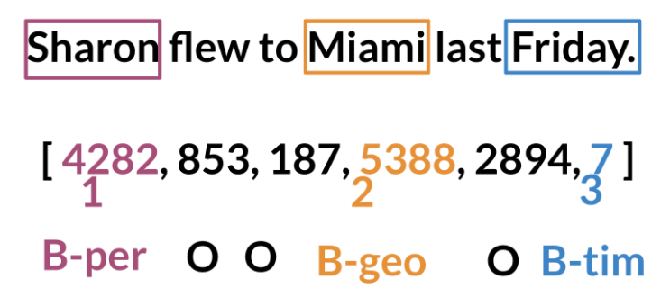
Data Processing
For NER, when training AI algorithms you have to:
Convert words and entity classes into arrays
Pad with tokens: Set sequence length to a certain number and use the <PAD> token to fill empty spaces
Create a data generator
Once you have that, you can assign each class a number, and each word a number.

Slide 14
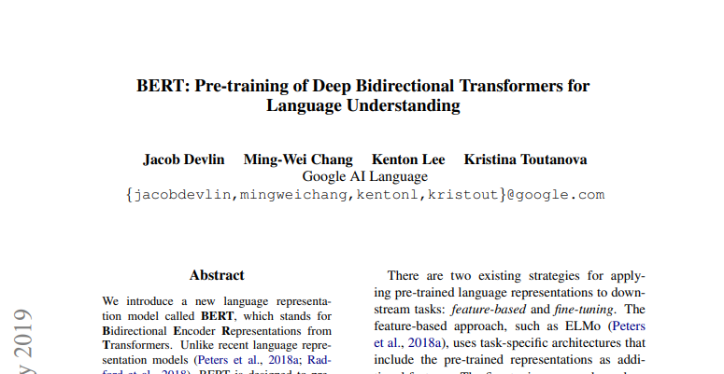
BERT
https://arxiv.org/pdf/1810.04805.pdf

Slide 15
BERT - Model Architecture
BERT architecture consists of multi-layer bidirectional transformer encoder
BERT Model provide in the paper came in two sizes
BERT_Base | BERT_Large
Layers = 12 | Layers = 24
Hidden size = 768 | Hidden size = 1024
Total parameters = 110M | Total parameters = 340M
https://arxiv.org/pdf/1810.04805.pdf

Slide 16
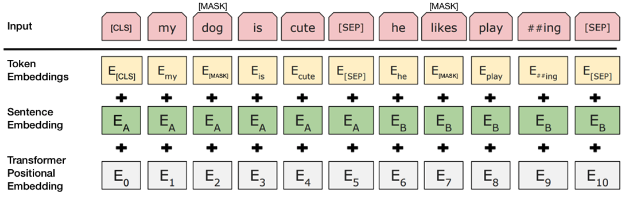
BERT - Input
https://arxiv.org/pdf/1810.04805.pdf

Slide 17
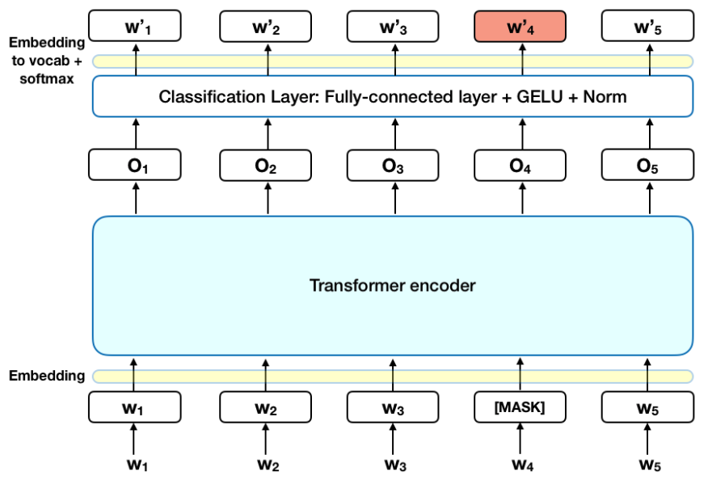
BERT - Model Architecture
https://arxiv.org/pdf/1810.04805.pdf

Slide 18
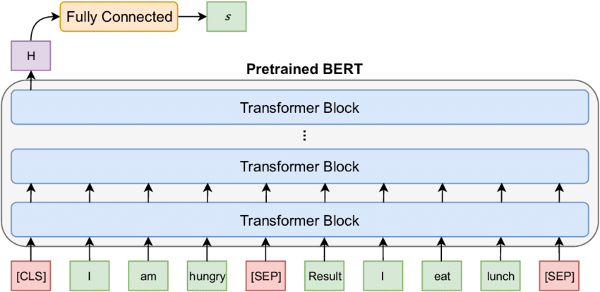
BERT - Model Architecture
https://arxiv.org/pdf/1810.04805.pdf

Slide 19
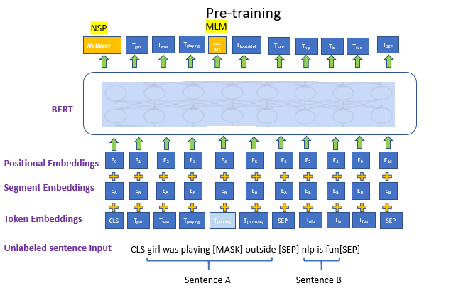
BERT - Masked Language Modeling (Pre-training)
https://arxiv.org/pdf/1810.04805.pdf

Slide 20
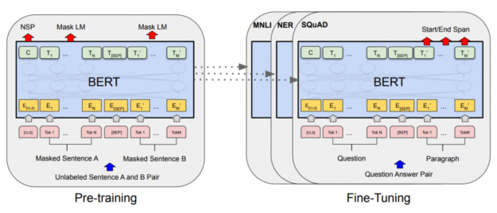
BERT - Fine Tuning
https://arxiv.org/pdf/1810.04805.pdf

Slide 21
References & Links
BERT paper: https://arxiv.org/pdf/1810.04805.pdf
Blog post: The Illustrated BERT… by Jay Alammar https://jalammar.github.io/illustrated-bert/
Hugging Face models: https://huggingface.co/models
NER dataset used in notebook: https://www.kaggle.com/abhinavwalia95/entity-annotated-corpus?select=ner_dataset.csv
Another dataset to use for NER: https://aclanthology.org/W03-0419.pdf

